Slide 1
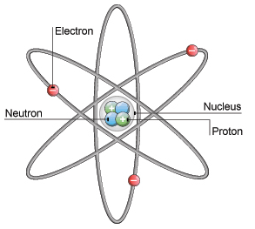
Daily Review
Describing the Structure of an Atom
State the number of protons and neutrons in the nucleus. State the number of electrons orbiting the nucleus. State whether the atom is neutral or charged. neutral = number of protons and electrons is equal charged = number of protons and electrons is not equal
Describe the structure of the helium atom.
There are ___ protons and ___ neutrons in the nucleus.
There are ___ electrons orbiting the nucleus.
The atom is ________ because __________.

Slide 2
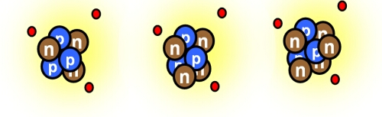
Daily Review
CFU 1
What is the atomic weight of each of these lithium atoms?
Atomic Weight
The weight of an atom is found by adding the number of protons and neutrons.
Different isotopes are written with their atomic weight after the element name, for example helium-4 or helium-5.
CFU 2
Write the name of each lithium isotope.

Slide 3
Radioactivity and Half-Life

Slide 4
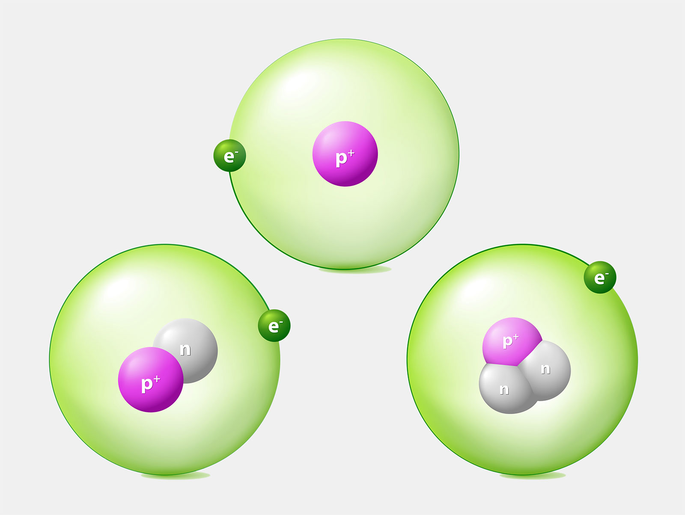
Learning Objectives
CFU
What are we going to learn?
Define radioisotopes.
Define half-life of radioisotopes
Use half-life to calculate the remaining amount of radioactive samples.
Activate Prior Knowledge
Look at the picture of the three atoms.
Think-pair-share: How are these three atoms the same? How are they different?
Isotopes of which element are represented in the picture?

Slide 5
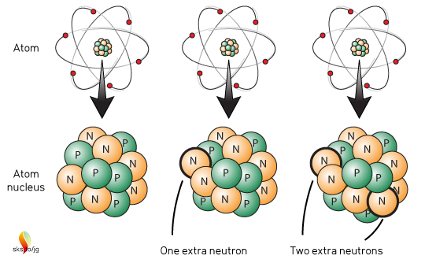
Concept Development
CFU 1
What in the nucleus of an element can change?
Isotopes
While the number of protons in the nucleus of atoms in an element stays the same, the number of neutrons can change.
Atoms of the same element, but with different numbers of neutrons are called isotopes.
For example, the carbon isotopes all have 6 protons, but have different numbers of neutrons.
CFU 2
Explain what is meant by the term ‘isotope’.
CFU 3
Why are the three atoms shown classified as isotopes?
Vocabulary
Subatomic: smaller than, or occurring within, an atom

Slide 6
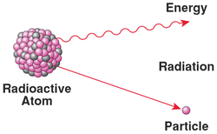
Concept Development
CFU 1
What happens to unstable isotopes?
Radioisotopes
In some isotopes, when the ratio of neutrons to protons is too high, the nucleus is unstable.
These unstable isotopes decay or change into another isotope that is more stable.
When isotopes decay, they emit particles and radiation.
Isotopes that emit radiation are called radioisotopes.
CFU 2
What is released from atoms as they decay?

Slide 7
Concept Development
CFU 1
Why does the radioactivity of a sample drop over time?
Radioactive Half-Life
Radioactive decay is a random process, so we cannot predict exactly when a radioactive nucleus will decay.
As a radioactive sample decays, less and less of the original substance is left, so the radioactivity drops.
The half-life of a radioactive material, is the time taken for half of the radioactive nuclei in the sample to decay.
This is also when the radioactivity of the sample is reduced to half its original level.
CFU 2
What is the half-life of a radioactive material?
CFU 3
Iodine-131 has a half-life of 8 days. What happens to the radioactivity over that amount of time?

Slide 8
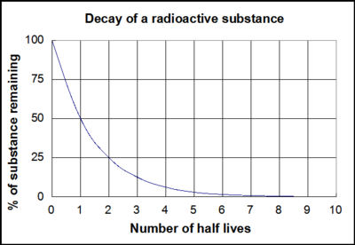
Concept Development
CFU 1
When 3 half-lives have passed, how much radioactivity remains?
Radioactive Half-Life
When one half-life has passed, the radioactivity reaches half of its original level.
When two half-lives have passed, the radioactivity reached a quarter of its original level (half of a half).
After three half-lives, an eighth of the original level of radioactivity remains.
CFU 2
If 75% (or ¾) of the radioactivity remains, how many half-lives have passed?
CFU 3
Iodine-131 has a half-life of 8 days. How many days have passed if the radioactivity level is at 25%?

Slide 9
Concept Development
CFU 1
After 12 hours, how much radioactivity remains in a sample of technetium-99?
Radioactive Half-Life
Different radioisotopes have different half-lives.
Some half-lives are measured in minutes, some in days, and some in years.
CFU 2
When one half-life of chromium-51 passes, how many have passed for lutetium-177?
Radioisotope | Half-Life
Bismuth-213 | 46 minutes
Technetium-99 | 6 hours
Lutetium-177 | 7 days
Iodine-131 | 8 days
Chromium-51 | 28 days
Carbon-14 | 5739 years

Slide 10
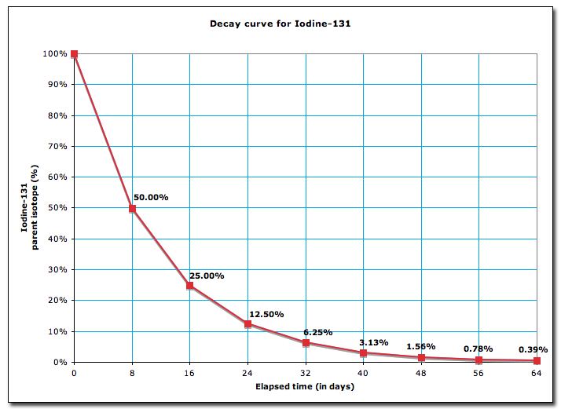
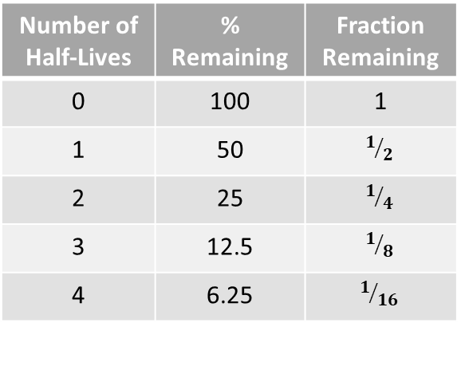
Skill Development/Guided Practice
Number of Half-Lives | % Remaining | Fraction Remaining
0 | 100 | 1
1 | 50 | $$1/2$$
2 | 25 | $$1/4$$
3 | 12.5 | $$1/8$$
4 | 6.25 | $$1/{16}$$
Interpreting Half-Life Graphs
Use the graph to determine the half-life of the radioisotope. Calculate the number of half-lives that have passed. State the percentage or fraction of radioisotopes remaining in the sample.
What fraction of Iodine-131 remains after 16 days?
CFU 1
What is the half-life of the radioisotope?
The half-life of Iodine-131 is 8 days.
CFU 2
How many half-lives have passed?
In 16 days, two half-lives have passed.
There would be ¼ of the radioisotopes remaining.
CFU 3
What amount of the radioisotope remains?

Slide 11
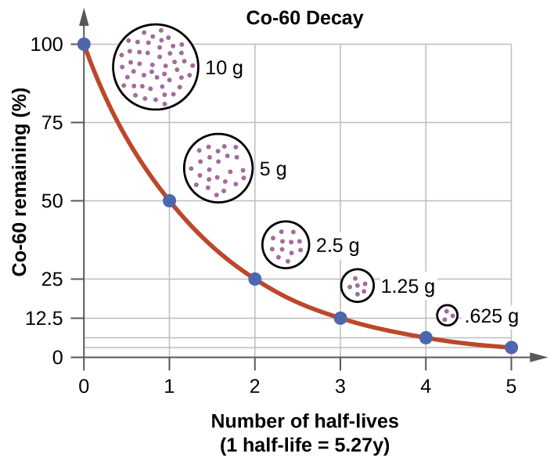
Skill Development/Guided Practice
Number of Half-Lives | % Remaining | Fraction Remaining
0 | 100 | 1
1 | 50 | $$1/2$$
2 | 25 | $$1/4$$
3 | 12.5 | $$1/8$$
4 | 6.25 | $$1/{16}$$
Interpreting Half-Life Graphs
Use the graph to determine the half-life of the radioisotope. Calculate the number of half-lives that have passed. State the percentage or fraction of radioisotopes remaining in the sample.
What percentage of Cobalt-60 remains after 15 years?
CFU 1
What is the half-life of the radioisotope?
The half-life of Cobalt-60 is 5 years.
CFU 2
How many half-lives have passed?
In 15 years, three half-lives have passed.
There would be 12.5% of the radioisotopes remaining.
CFU 3
What amount of the radioisotope remains?

Slide 12
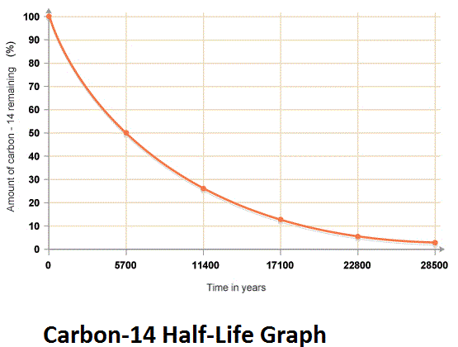
Skill Development/Guided Practice
Number of Half-Lives | % Remaining | Fraction Remaining
0 | 100 | 1
1 | 50 | $$1/2$$
2 | 25 | $$1/4$$
3 | 12.5 | $$1/8$$
4 | 6.25 | $$1/{16}$$
Interpreting Half-Life Graphs
Use the graph to determine the half-life of the radioisotope. Calculate the number of half-lives that have passed. State the percentage or fraction of radioisotopes remaining in the sample.
What fraction of Carbon-14 remains after 11400 years?
CFU 1
What is the half-life of the radioisotope?
The half-life of Carbon-14 is 5700 years.
CFU 2
How many half-lives have passed?
In 11400 years, two half-lives have passed.
There would be 25% of the radioisotopes remaining.
CFU 3
What amount of the radioisotope remains?

Slide 13
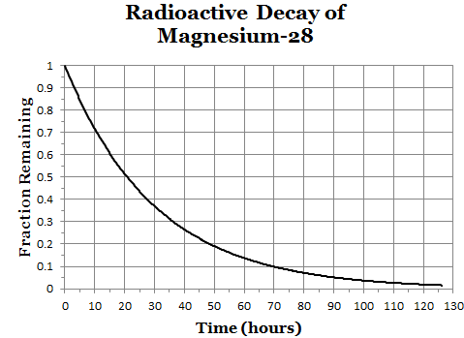
Skill Development/Guided Practice
Number of Half-Lives | % Remaining | Fraction Remaining
0 | 100 | 1
1 | 50 | $$1/2$$
2 | 25 | $$1/4$$
3 | 12.5 | $$1/8$$
4 | 6.25 | $$1/{16}$$
Interpreting Half-Life Graphs
Use the graph to determine the half-life of the radioisotope. Calculate the number of half-lives that have passed. State the percentage or fraction of radioisotopes remaining in the sample.
What percentage of Magnesium-28 remains after 2.5 days?
CFU 1
What is the half-life of the radioisotope?
The half-life of Magnesium-28 is 20 hours.
CFU 2
How many half-lives have passed?
In 2.5 days, three half-lives have passed.
There would be 12.5% of the radioisotopes remaining.
CFU 3
What amount of the radioisotope remains?

Slide 14
Relevance
Radioisotopes and the radiation they produce are used in a wide variety of applications. For example:
The decay of Carbon-14 can be used to calculate the age of many plant based objects in a process called carbon dating.
Some radioisotopes are used to produce images of the human body. Radioisotopes are injected into the body, and accumulate in particular organs. The radioactivity can then be detected and used to form an image.
Radioactive materials can be used in the production of electricity. Waste products from nuclear power plants need to be stored until the radiation they produce reaches a safe level, which depends on the half-life of the radioisotope.

Slide 15
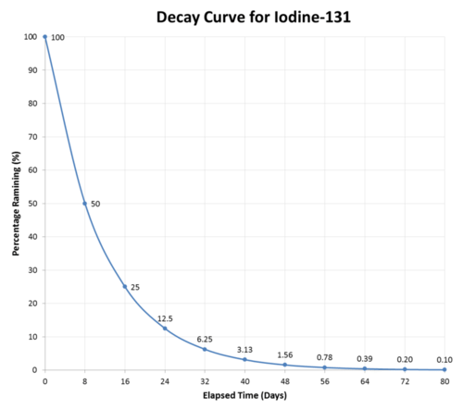
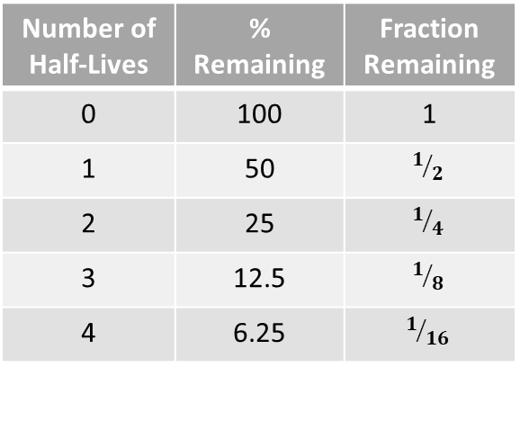
Skill Closure
What is a radioisotope?
Skill Closure
Number of Half-Lives | % Remaining | Fraction Remaining
0 | 100 | 1
1 | 50 | $$1/2$$
2 | 25 | $$1/4$$
3 | 12.5 | $$1/8$$
4 | 6.25 | $$1/{16}$$
What does the term half-life mean?
Skill Closure
If 75% of the radioisotopes in a sample of Iodine-131 have decayed, how much time has passed?

Slide 16
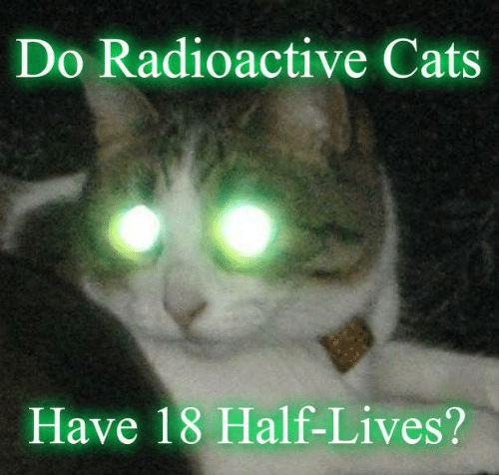
Independent Practice
Complete the Half-Life Decay worksheet on a paper copy.

